Slide 1


FEE
PROJECT EVALUATION
Submit to-
Ms.Preenu Mittan

Slide 2

INTRODUCTION
In today's dynamic world, where knowledge is the currency of progress,Learnify stands as a beacon of accessible education, breaking barriers and opening doors to learning opportunities for all.
At Learnify, we believe that education knows no bounds. If you are seeking to upskill, or craving interactive learning experiences, or an enthusiast eager to explore new realms of knowledge, our platform caters to your diverse learning needs.

Slide 3

OUR TEAM
Arnav Jain-2210991349
Arnav Garg-2210991348
Azimusshan Khan-2210991432

Slide 4
PROBLEM STATEMENT
Traditional education systems struggle to provide equitable access, personalized learning experiences, and relevant skills training, hindering individuals' ability to thrive in a rapidly evolving world. Our mission is to revolutionize education by leveraging technology and promote lifelong skill development for success in the digital age.

Slide 5
SOLUTION OFFERED:
Accessible Learning:
Personalized Learning:
Comprehensive Skill
Development:
Breaking geographical barriers with online access, ensuring anyone anywhere can pursue educatioe conveniently
Tailoring courses to individual
needs fostering engagement and deeper understanding through adaptive learning
technologies.
Offering a diverse range of courses
spanning various disciplines, from foundational knowledge to specialized skills, ensuring learners are equipped for success in their chosen fields.

Slide 6

OBJECTIVES:
Educational Accessibility
User Engagement
Personalized Learning
Content Quality
Community Building(Forums)
Monetization Strategy
Scalability and Future Growth

Slide 7
TECHNICAL DETAILS :
Tech Stack (Frontend):
CSS: Styling, layout, responsiveness.
JavaScript : Interactivity, animations, API calls.
React: React is a JavaScript library for building user interfaces.

Slide 8






PROJECT TIMELINE: FROM CONCEPT TO LAUNCH
Planning and Research
Checking and Refinement
Feature Expansion
(Conducted research and define project objectives)
(Conduct usability testing)
(Plan for future updates and enhancements.)
Development
Submission of the Project
(Coding the website and adding functionality.)
(Launch website and monitor performance.)

Slide 9
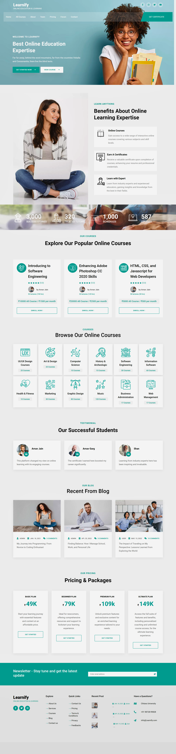
Project Highlights

Slide 12
KEY FEATURES
01
02
03
Create, organize, and manage courses with ease.
Deliver diverse educational
content including text,
videos, and assessments.
Enable sharing and connecting with peers on discussion forums.

Slide 13
CONCLUSIONS
Online education platforms revolutionize learning with accessibility, flexibility, and quality.
Learners benefit from personalized learning experiences tailored to their needs.
Embracing innovation, they democratize education and promote lifelong learning.
Online education platforms play a pivotal role in shaping the future of education.

Slide 14

THANK YOU

